Slide 1

DriverPass
System Analysis
David Silva
Notes:
[No speaker notes required for this slide.]

Slide 2

System Requirements
Functional Requirements
The system must allow students to schedule, manage, and view upcoming driving lessons.
The system must validate user credentials and restrict access to authorized users only.
Nonfunctional Requirements
The system must be available 24/7 with minimal downtime to support student scheduling.
The system must ensure secure handling of user data, including encrypted passwords and protected payment information.
Notes:
For this system, I identified two functional requirements and two nonfunctional requirements that directly support DriverPass’s goals. The functional requirements focus on what the system must do. First, students must be able to schedule, manage, and view their upcoming driving lessons, because scheduling is one of the core services DriverPass provides. Second, the system must validate user credentials and restrict access only to authorized users. This protects student accounts and ensures that only legitimate users can schedule lessons or take practice tests.
The nonfunctional requirements describe how the system should operate. The system needs to be available 24/7 with minimal downtime so students can access their accounts and schedule lessons whenever they need to. Additionally, the system must securely handle all user data by encrypting passwords and protecting payment information. Together, these requirements ensure DriverPass can deliver a reliable, secure, and user-friendly service that meets both business and student needs.

Slide 3
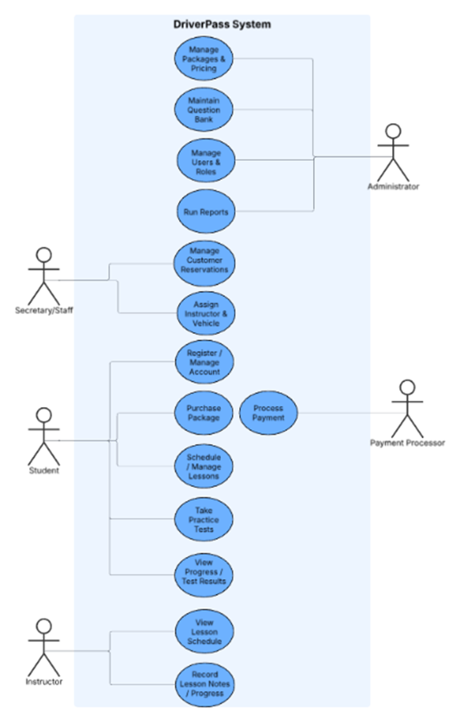
Use Case Diagram
Notes:
In this diagram, I outlined all the different groups of people who interact with the DriverPass system and the tasks they need the system to help them complete. The main groups include students, instructors, office staff, an administrator, and the external payment service.
Students use the system to create and manage their accounts, buy lesson packages, schedule and manage driving lessons, take online practice tests, and check their progress. Instructors use the system to view their lesson schedules and record notes after each lesson. Office staff are responsible for handling customer reservations and assigning instructors and vehicles. The administrator manages pricing, the question bank for practice tests, user permissions, and system reporting. The payment processor is included because students need a secure way to make purchases through the platform.
Each task shown in the diagram represents an important part of the DriverPass solution. I organized these tasks to reflect the needs described by the client during the interview: students must be able to practice online, book lessons easily, and track their improvement; instructors and staff must be able to manage schedules efficiently; and administrators must be able to maintain the system. This structure ensures that every major workflow DriverPass requested is fully supported.

Slide 4
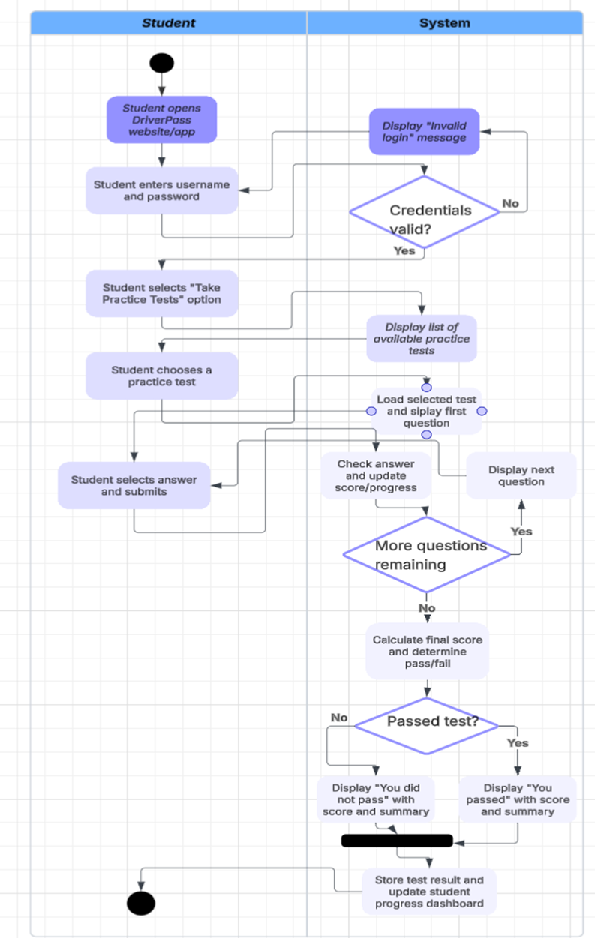
Activity
Diagram
Notes:
This activity diagram breaks down the steps a student follows when using the system to take a practice test.
It begins when the student opens the DriverPass website or app and signs in with their username and password. The system checks whether the login information is correct. If it isn’t, the student is told the login failed. If the login is valid, the student can continue.
The student then chooses the option to take a practice test. The system shows a list of tests, and the student picks one. After a test is selected, the first question appears.
For each question, the student chooses an answer and submits it. The system checks the answer, updates their score, and moves to the next question as long as there are more remaining.
Once all questions are answered, the system calculates the student’s final score and determines whether they passed. If they passed, the system shows a message congratulating them along with their score. If they didn’t pass, it shows a summary of how they did.
At the end, the system saves the test result and updates the student’s progress dashboard so they can review their performance in the future.
This design supports DriverPass’s goals by giving students a clear, structured path to practice for their DMV exam. It also tracks their progress over time, helping them understand where they need improvement and making the service more valuable.

Slide 5
Security
Login requires a username and password so only approved users can get into the system.
Different types of users (students, instructors, staff, admins) only see the features they are supposed to use.
Personal details and payment information are protected when they are sent and stored in the system.
Activity in the system can be monitored and backed up so issues can be found and recovered if needed.
Notes:
In this design I tried to make security part of every step, not just an afterthought.
First, no one can use DriverPass without signing in with a username and password. That helps keep random people from getting into the system.
Second, once a user signs in, they only see the parts of the system that match their role. For example, students can schedule lessons and take practice tests, but they cannot change prices or see other students’ information. Instructors can record lesson notes, but they cannot process payments. This reduces the chances of accidental or intentional misuse.
Third, personal information and payment details are protected while they move between the user’s browser and the DriverPass servers, and while they are stored. This helps prevent things like addresses or card numbers from being exposed if someone tries to listen in.
Finally, the system is designed so activity can be logged, and data can be backed up. If something goes wrong or suspicious behavior occurs, DriverPass can review what happened and restore lost information if needed.
Altogether, these choices help keep student data safe and give DriverPass a system they can trust for everyday use.

Slide 6
System
Limitations
The system depends on a stable internet connection, so users may have trouble accessing it during outages.
Students must already own a device like a phone or computer to use the system.
If information is typed in incorrectly, the system cannot always catch human mistakes.
Some features, like scheduling and payments, rely on outside services that could slow things down.
The system cannot prevent all misuse if someone shares their login information with others.
Notes:
In this design, I considered the areas where the system still has limits even though it meets DriverPass’s needs. One limitation is that the system requires a good internet connection. If the internet is slow or unavailable, students may not be able to log in or schedule lessons. The system also assumes that all users have access to a computer or mobile device, which may not always be true.
Another limitation is that the system relies on people entering correct information. If a student mistypes something, the system cannot always fix the error on its own. Some parts of the system, like payments or scheduling, depend on outside services, so if one of those slows down, the whole process can be affected.
Finally, the system cannot control what users do with their passwords. If someone shares their login with another person, it becomes harder to protect their information. Even with these limits, the system still gives DriverPass a strong foundation for scheduling lessons, taking tests, and managing user accounts.

